Slide 1
Multimedia Networking
By Pankaj kc
Batch: 2016
Computer NEtworks

Slide 2
Outlines
Difference with classic applications
Classes of multimedia applications
  Requirements/Constraints
Problems with today’s Internet and solutions
Common multimedia protocols
  RTP, RTCP
Accessing multimedia data through a web server
Conclusion

Slide 3
Difference with classic applications
Highly delay-sensitive
  Packets are useless if they arrive too late
Loss-tolerant (for the most part)
  Packet loss can be concealed

Slide 4
Outlines
Difference with classic applications
Classes of multimedia applications
  Requirements/Constraints
Problems with today’s Internet and solutions
Common multimedia protocols
  RTP, RTCP
Accessing multimedia data through a web server
Conclusion

Slide 5
Classes of multimedia Applications
Streaming Stored Audio and Video
Streaming Live Audio and Video
Real-Time Interactive Audio and Video
Others

Slide 6
Class: Streaming Stored Audio and Video
The multimedia content has been prerecorded and stored on a server
User may pause, rewind, forward, etc…
The time between the initial request and display start can be 1 to 10 seconds

Slide 7
Class: Streaming Live Audio and Video
Similar to traditional broadcast TV/radio, but delivery on the Internet
Non-interactive just view/listen
  Can not pause or rewind
Often combined with multicast
The time between the initial request and display start can be up to 10 seconds

Slide 8
Class: Real-Time Interactive Audio and Video
Phone conversation/Video conferencing
Constraint: delay between initial request and display start must be small
  Video: <150 ms acceptable
  Audio: <150 ms not perceived, <400 ms acceptable

Slide 9
Class: Others
Multimedia sharing applications
  Download-and-then-play applications
  E.g. Napster, Gnutella
  Distance learning applications
  Coordinate video, audio and data

Slide 10
Outlines
Difference with classic applications
Classes of multimedia applications
  Requirements/Constraints
Problems with today’s Internet and solutions
Common multimedia protocols
  RTP, RTCP
Accessing multimedia data through a web server
Conclusion

Slide 11
Challenge
TCP/UDP/IP suite provides best-effort, no guarantees on expectation or variance of packet delay
Performance deteriorate if links are congested (transoceanic)
Most router implementations use only First-Come-First-Serve (FCFS) packet processing and transmission scheduling

Slide 12
Problems and solutions
Limited bandwidth
  Solution: Compression
Packet Jitter
  Solution: Fixed/adaptive playout delay for Audio (example: phone over IP)
Packet loss
  Solution: FEC, Interleaving

Slide 13
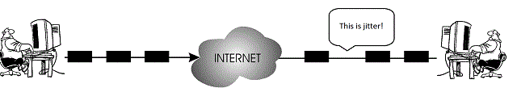
Problem: Packet Jitter
Jitter: Variation in delay
Example
Sender
No jitter
6
5
4
3
2
1
Receiver
Jitter
5
6
4
3
2
1
pkt 6
pkt 5

Slide 14
Dealing with packet jitter
How does Phone over IP applications limit the effect of jitter?
  A sequence number is added to each packet
  A timestamp is added to each packet
  Playout is delayed

Slide 15
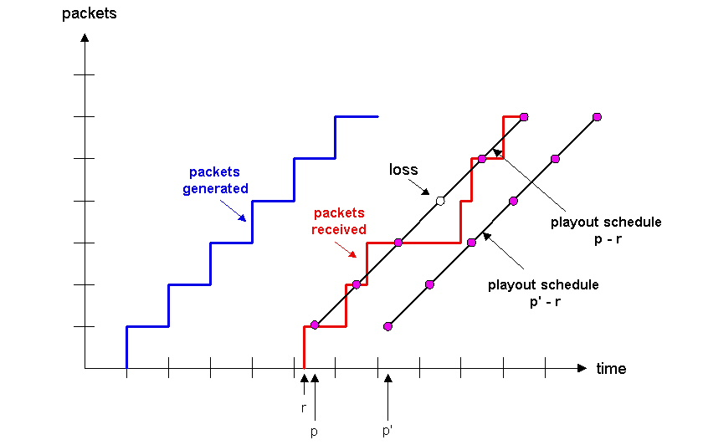
Dealing with packet jitter
Fixed playout delay
Fixed playout delay

Slide 16
Problem: Packet loss
Loss is in a broader sense: packet never arrives or arrives later than its scheduled playout time
Since retransmission is inappropriate for Real Time applications, FEC or Interleaving are used to reduce loss impact.

Slide 17
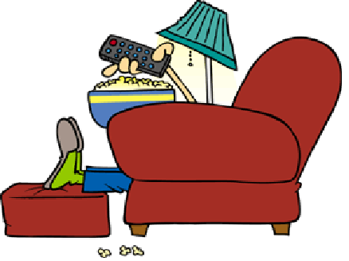
Movie Time

Slide 18
Outlines
Difference with classic applications
Classes of multimedia applications
  Requirements/Constraints
Problems with today’s Internet and solutions
Common multimedia protocols
  RTP, RTCP
Accessing multimedia data through a web server
Conclusion

Slide 19
Real Time Protocol (RTP)
RTP logically extends UDP
  Sits between UDP and application
  Implemented as an application library
What does it do?
  Framing
  Multiplexing
  Synchronization
  Feedback (RTCP)

Slide 20

RTP packet format
Payload Type: 7 bits, providing 128 possible different types of encoding; eg PCM, MPEG2 video, etc.
Sequence Number: 16 bits; used to detect packet loss

Slide 21
RTP packet format (cont)
Timestamp: 32 bytes; gives the sampling instant of the first audio/video byte in the packet; used to remove jitter introduced by the network
Synchronization Source identifier (SSRC): 32 bits; an id for the source of a stream; assigned randomly by the source

Slide 22
Timestamp vs. Sequence No
Timestamps relates packets to real time
  Timestamp value sampled from a media specific clock
Sequence number relates packets to other packets

Slide 23
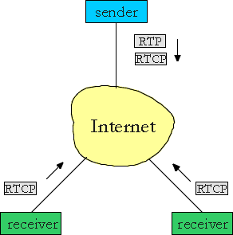
RTP Control Protocol (RTCP)
Used in conjunction with RTP. Used to exchange control information between the sender and the receiver.
Three reports are defined: Receiver reception, Sender, and Source description
Reports contain statistics such as the number of packets sent, number
of packets lost,
inter-arrival jitter
Typically, limit the
RTCP bandwidth to 5%.
Approximately one
sender report for three
receiver reports

Slide 24
Outlines
Difference with classic applications
Classes of multimedia applications
  Requirements/Constraints
Problems with today’s Internet and solutions
Common multimedia protocols
  RTP, RTCP
Accessing multimedia data through a web server
Conclusion

Slide 25
Streaming Stored Multimedia Example
Audio/Video file is segmented and sent over either TCP or UDP, public segmentation protocol: Real-Time Protocol (RTP)
User interactive control is provided, e.g. the public protocol Real Time Streaming Protocol (RTSP)

Slide 26
Streaming Stored Multimedia Example
Helper Application: displays content, which is typically requested via a Web browser; e.g. RealPlayer; typical functions:
  Decompression
  Jitter removal
  Error correction: use redundant packets to be used for reconstruction of original stream
  GUI for user control

Slide 27
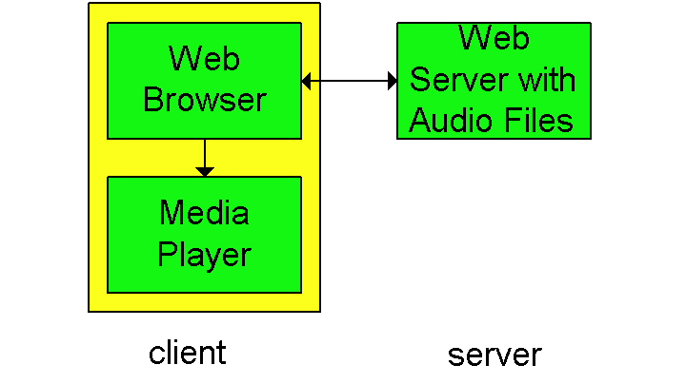
Streaming from Web Servers
Audio: in files sent as HTTP objects
Video (interleaved audio and images in one file, or two separate files and client synchronizes the display) sent as HTTP object(s)
A simple architecture is to have the Browser request the object(s)
and after their
reception pass
them to the player
for display
  - No pipelining

Slide 28
Streaming from a Web Server (cont)
Alternative: set up connection between server and player, then download
Web browser requests and receives a Meta File
(a file describing the object) instead of receiving the file itself;
Browser launches the appropriate Player and passes it the Meta File;
Player sets up a TCP connection with a streaming server Server and downloads the file

Slide 29
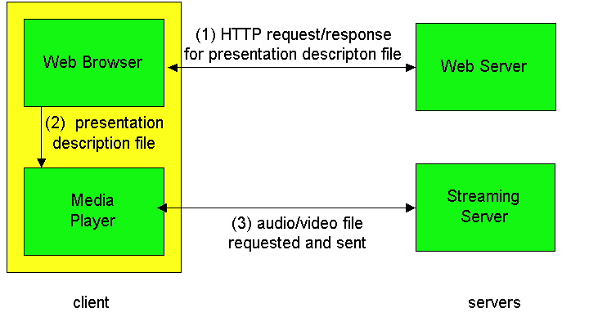
Using a Streaming Server

Slide 30
Options when using a streaming server
Use UDP, and Server sends at a rate (Compression and Transmission) appropriate for client; to reduce jitter, Player buffers initially for 2-5 seconds, then starts display
Use TCP, and sender sends at maximum possible rate under TCP; retransmit when error is encountered; Player uses a much large buffer to smooth delivery rate of TCP

Slide 31
Real Time Streaming Protocol (RTSP)
For user to control display: rewind, fast forward, pause, resume, etc…
Out-of-band protocol (uses two connections, one for control messages (Port 554) and one for media stream)
RFC 2326 permits use of either TCP or UDP for the control messages connection, sometimes called the RTSP Channel
As before, meta file is communicated to web browser which then launches the Player; Player sets up an RTSP connection for control messages in addition to the connection for the streaming media

Slide 32
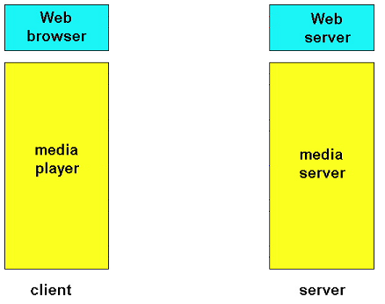



RTSP Operations
S: RTSP/1.0 200 1 OK
Session 4231
C: PLAY rtsp://audio.example.com/twister/audio.en/lofi RTSP/1.0
Session: 4231 Range: npt=0-
S: RTSP/1.0 200 1 OK
Session 4231
C: PAUSE rtsp://audio.example.com/twister/audio.en/lofi RTSP/1.0
Session: 4231 Range: npt=37
S: RTSP/1.0 200 1 OK
Session 4231
C: TEARDOWN rtsp://audio.example.com/twister/audio.en/lofi RTSP/1.0
Session: 4231
S: RTSP/1.0 200 1 OK
Session 4231
C: SETUP rtsp://audio.example.com/twister/audio RTSP/1.0
Transport: rtp/udp; compression; port=3056; mode=PLAY

Slide 33
Outlines
Difference with classic applications
Classes of multimedia applications
  Requirements/Constraints
Problems with today’s Internet and solutions
Common multimedia protocols
  RTP, RTCP
Accessing multimedia data through a web server
Conclusion

Slide 34
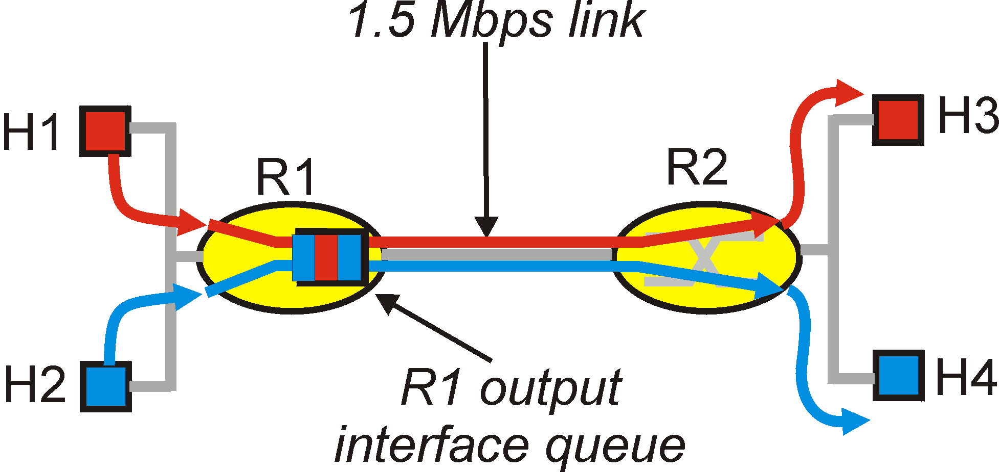
Conclusion
None of the proposed solutions give a real guarantee to the user that multimedia data will arrive on time.
Couldn’t we reserve some bandwidth for our multimedia transfer?

